Slide 1
THE PRACTITIONERS’ WORKING TABLE Inaugural Meeting
Field Launch!
Bwindi, Uganda
November 2016
© Elizabeth Walker 2016
Founder, The Practitioners’ Working Table
www.transcenddiscipline.com

Slide 2
Inaugural Working Table Meeting
Draft Agenda
 | Day 1 November 26 | Day 2 November 27
AM | A Brief to Fire Us Up! Our Story Our Chance Who’s Watching | “Drawing Board” Outputs Measurement Team Engagement
 | Open Discussion | Funding Strategy Positioning Mechanics Priorities
PM | “Drawing Board” Framing the “Board” Year 1 Fieldwork | Securing Sustaining Investment Requirement Next Steps
 | Portfolio Selection and Complementarity | Road Ahead WT Expansion 501(c)3 Considerations

Slide 3
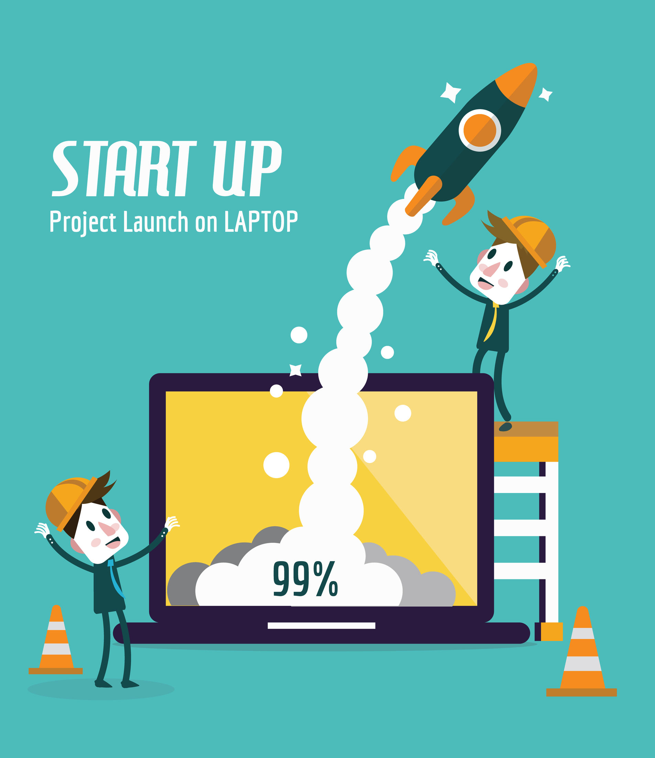
Our Story in 10 Seconds
Now!
What If?

Slide 4
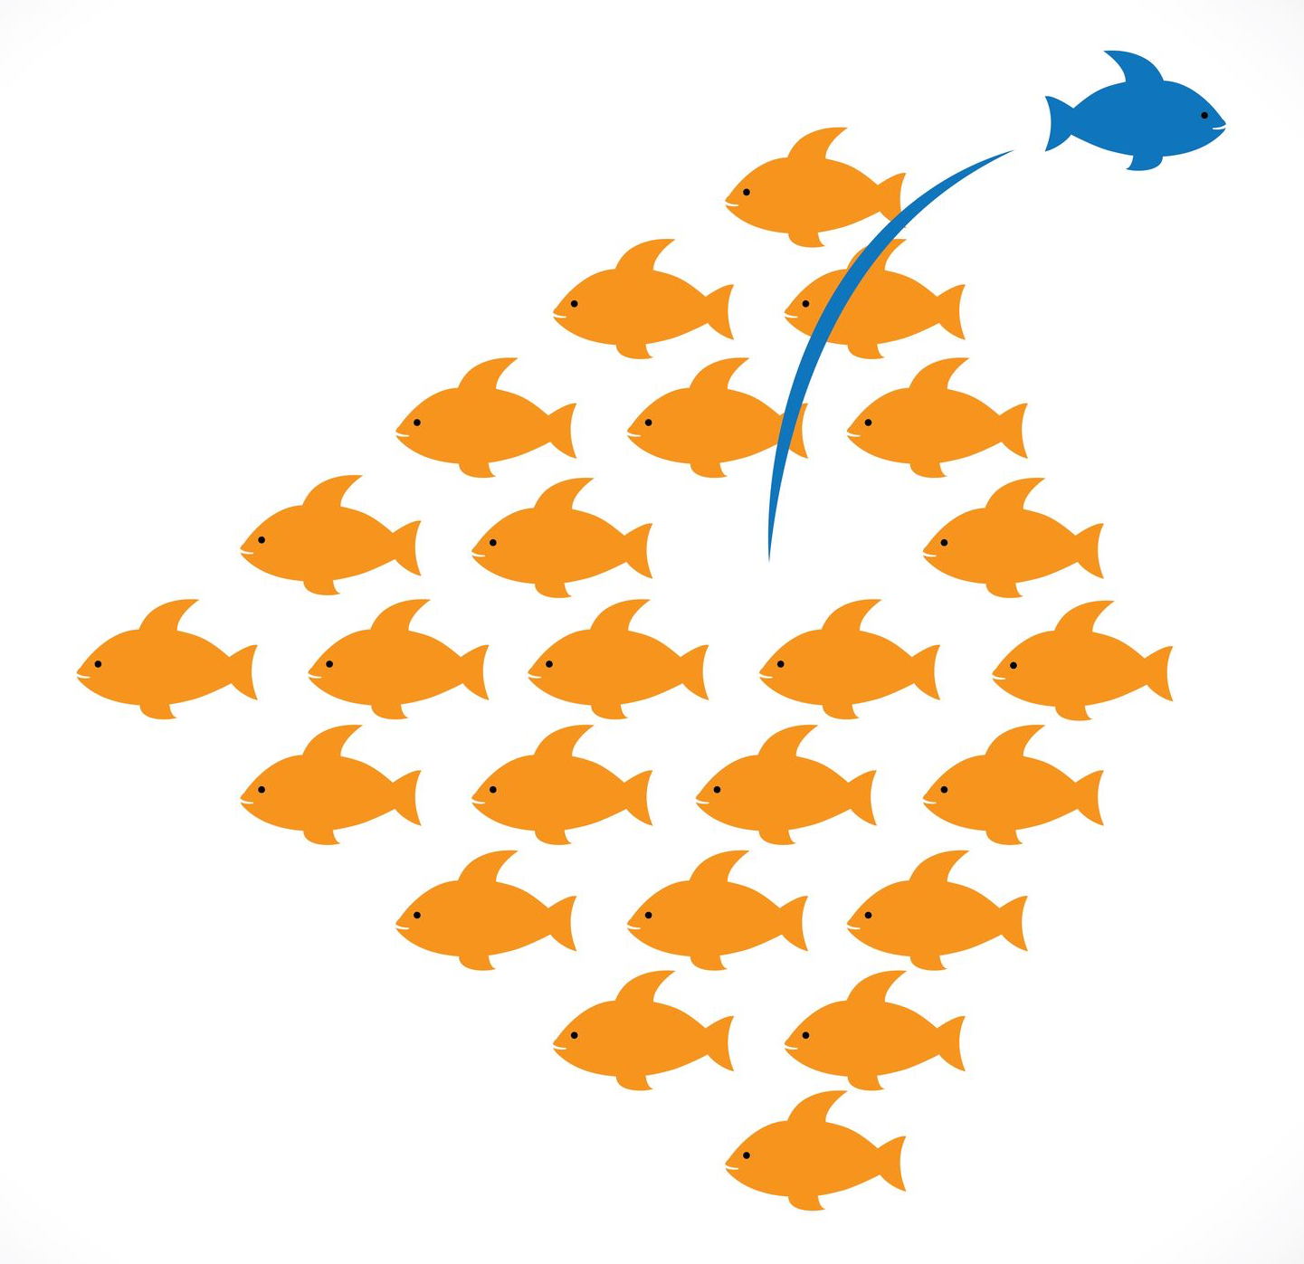
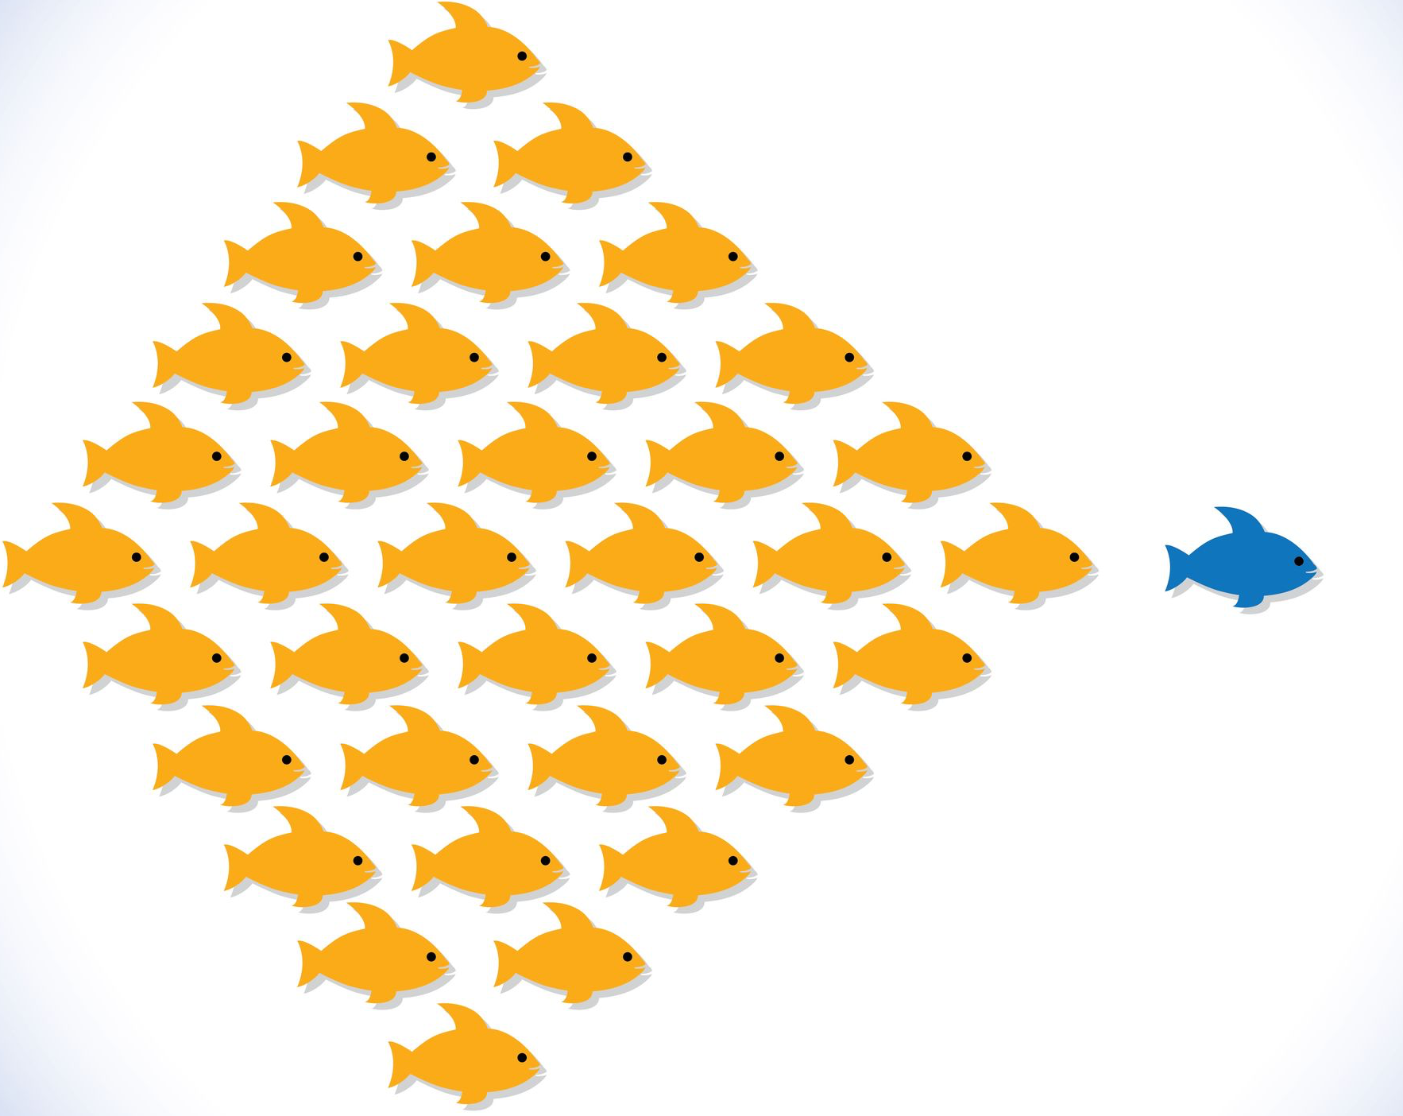
Or Told In Another Way

Slide 5
Our Story in Five Chapters
Part I: The Essentials
Part II: Strategy to Launch
Part III: Fieldwork
Part IV: Moving Forward
Part V: Inaugural Agenda

Slide 6
PART I: The Essentials

Slide 7
Who We Are
We’re the world's 1st Practitioners' Working Table
testing bold work and ideas
at the convergence of
conservation and development practice.
Because we believe that the
future of our practice will be shaped at the deep
joining of our talents, expertise and insights.
INTERDISCIPLINARY
Conservation
TRANSDISCIPLINARY
Development

Slide 8
What Brings Us Together
A desire to change the paradigm.
To break out from the limiting conventions and trappings of “discipline”…
That hold our fields hostage to stale conversation and methodology
That keep the goal posts still well within our comfort zones but well short of our potential
That limit talk to the tactics our fields can share rather than the strategy we must
That protect our fields, brands and revenue lines, rather than super-charge our impact
That stifle the agitation and creative impulse of our field colleagues
And that slow breakthrough work and real design innovation.
But Look… We’re INTEGRATING!
Fund Me!
Work Here!
Fund Me!
Work Here!
Small-Scale
Cautious
Revenue-Driven
TRANSDISCIPLINARY
Brand-Driven
Conservation
Development

Slide 9
What Inspires Us
Above all, each other.
An affirming desire to see every field practitioner with a footprint in the world released from stubborn conventions binding thinking and work
A desire to see every practitioner inspired, empowered and equipped…
To protect and preserve our human and natural world…
To remedy the imbalance in our work’s designs…
To boldly “equalize” conservation and development outcomes…
To subjugate concern for brand and organizational “identity” to ground impact…
And to do it no matter setting or scale…
And no matter organization, brand or funder…
Because an enduring impact depends on it.
It should be our obligation and our standard.
It’s common sense and cutting-edge.

Slide 10
What Sets Us Apart
There’s simply no other initiative like it across the global community of practitioners and funders, in vision, spirit or mechanics.
We’re a ground-up collaboration of practitioners, not a coalition of brands and organizations.
We’re aspiring to break the binary, not settling to bend it.
We want to close the gaps between our fields, not bridge them.
We’re bravely exploring our convergence, not integration.
We’re challenging trendy fixations with “integrated development” and “community-centered conservation” that protectively keep each of our fields at the center of our own models.
We’re fully open-source, putting the inspiration and tools for change in the hands of field colleagues worldwide eager to fix, act and impact, not in research agendas, on executive flipcharts, in guarded memos, atop lecterns or in published manifestos.
We’re focused on working quietly in service and in hand with our field colleagues to inspire and effect change, not on headlining events.

Slide 11
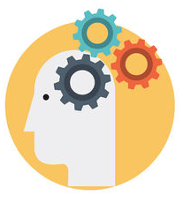
What We Said We’ll Do
Inspire positively transformative change to convention, in part by the powerful example of our collaboration and vision
Pilot and showcase breakthrough design innovation
Influence next-generation practitioners, scholars and funders
Invigorate a conversation, not settle the debate
REIMAGINE
REDESIGN
RENEW
Test and refine ground-rumbling ideas that reorient our fields behind a unifying strategy and empower practitioners to simply design for impact, rather than for discipline

Slide 12
Trial Use of a New Kind of “Umbrella” Strategy…
What
Trans-Disciplinary Design Approaches Sit Here at the Balance Point ??
Civil Engagement
(Independence, Protection,
Viability, Vibrancy)
Convergence
Justice
(Civic & Environmental, Rights, Remedy, Enforcement, Incentive, Consequence)
Governance
(Institutional & Regulatory Efficacy, Accountability, Transparency, Participation)
A Model in Motion
Exceptional design requires both a pivotal BALANCE of considerations and, importantly, MOMENTUM.
As the “Design Disc” spins atop
the point of its base, the balance of our disciplines both stabilize and propel it. Its spin ultimately “blurs” the conventional separation
between our fields, and its momentum gives “lift” to the five anchoring tethers of our work and obligation, what can be thought of as five universal “Levers of Change”
(Justice, Equity, Stewardship, Governance, Civil Engagement).
Their “lift” ultimately gives
the scale of change we seek
its real force, no matter
our core discipline.
Project
Design
Spin Weight
Spin Weight
Conservation
Development
PROGRESS
Equity
(Power, Access, Inclusion,
Distribution, Responsibility)
Stewardship
(Human & Wild, Population & Community,
Natural, Human & Financial Capital)
…to unbolt, reexamine, reconfigure and rebalance project designs.
© Elizabeth Walker 2016
www.transcenddiscipline.com

Slide 13
How We Said We’ll Do It
With a whole lot of heart, grit and tenacity.
1) Original Idea Sharing: Share a bold, new, uplifting vision for our fields and breakout ideas on a truly global website;
2) Inventive Fieldwork: (Re)design work, in East Africa to start, to showcase the impact a new mindset and direction inspire, and the change evidenced when practitioners design from their heads, not their business cards; and
3) Path-Breaking Advocacy: Invite our fields and funders to throw off entrenched conventions stunting fresh, new ideas.
Let’s get started!
Begun!

Slide 14
PART II: Strategy to Launch

Slide 15
Our Three Engines
LIFE
REACH
EXPOSURE
A “smart,” elegant digital trail so we can be found and followed (a website and social media presence targeted initially to “big thinkers” and experienced practitioners, with message migration beginning to a more public audience )
A global community of allies across disciplines, organizations, institutions and geographies (one built on solidarity and inspiration, not on critique, brick-busting advocacy or grandstanding)
Targeted, discrete contact with select, vanguard innovation funders

Slide 16
Shaping Our Message for an Evolving Audience
First establishing credibility among a discerning jury of our peers.
Now reaching for a more public audience.

Slide 17
Our Growing Online Currency
Budding Twitter feed
Notable follows from UNEP, IUCN & ”thumbs up” from USAID Global Dev Lab
Re-tweeted often by #socent, #socimpact, #changemakers hashtag followers
Starting Facebook presence (created September 2016)
Have not yet paid for “boosts” or conducted formal page “like” campaigns
Substantial LinkedIn traffic generated from across 20+ Groups
TED Ideas Worth Sharing (unofficial)
Social Entrepreneur
Social Entrepreneurs’ Hub
Devex
Society for International Development
Global Development Professionals
Sustainable Development Africa
Biodiversity Professionals
Africa Wildlife Conservation Professionals
Nonprofit Innovation & Technology
Chronicle of Philanthropy
University Alumni Groups
A sustained presence to invite solidarity and interest, and to intrigue and inspire.

Slide 18
An Already Global Reach
Active Website Views by Field Practitioners & Social Entrepreneurs
120+ Countries in our first 120 Days!
Average 1,000+ unique visits per month. HALF are new visitors.

Slide 19
Our Financial Fuel
Innovation Partner
Field School Partner
Private Donors
Benefactor
$20,000+ Raised
120+ Donors Engaged
Top Strategic Priority
Launch & Rolling Priority
Establish Fieldwork
Latitude
Credibility
Reach
Visibility
Long-Range Priority

Slide 20
What Ground Control Looks Like
Or
Finding the “Match”!
LAUNCH
Take
Website “Live”
(“Soft Launch”)
Secure Innovation Partner
Secure Benefactor
Engage Private Donors
Done!
Begun!
…to Accelerate from Digital Launch to Full Field Launch!

Slide 21
Spirit and Principles Behind Finding Our “Match”
We’re not chasing money. We’re going to earn it.
We’re not force-fitting our vision to a funder’s scope.
We’re not drafting or submitting at-the-ready proposals.
We’re not circling in the razzmatazz of microphones, meetings and events.
We’re not rushing a decision that should be highly selective and inspiring.
We are discretely opening conversation and interest.
We are inviting potential investors to learn of our launch, explore the website, read what’s inspiring our collaboration, and watch our work.
We are committed to captivating and inspiring investment with our ideas, not formulating our ideas to available investment.
We do expect finding our “match” to take time, as the work by its very convention-defying nature falls outside conventional funding scopes and categories.
The work is not ordinary.
Our funding partners will be extraordinary too.

Slide 22
PART III: Fieldwork

Slide 23
Objectives of Fieldwork
Framed by the Working Table’s Goals
1. Trial and document, and where possible quantify, the change in ground impact that’s observed when an organization adopts a trans-disciplinary outlook, and designs or modifies its work through use of a trans-disciplinary strategic framework
2. Invigorate and amplify the important conversation needed around the case for trans-disciplinary practice, contributing experiential learning, inquiry, reflection, critique and original authorship
3. Explore and propose promising mechanisms by which practitioners, funders and researchers can contribute in meaningful ways to a trans-disciplinary movement and to its realization and testing in practice
4. Join our voices together thru digital, regional and international platforms in a clarion call for work that constructively and imaginatively challenges entrenched paradigms prejudicing outcomes and stifling more creative effort
Fieldwork will TRIAL, DOCUMENT and CONTRIBUTE.

Slide 24
Guiding Principles Behind Fieldwork
We’re Ground-Testing and Impact-Testing.
We’re building a body of “casework” that examines what a trans-disciplinary outlook means in nuts and bolts to projects and practice.
We’re trialing adoption of a fundamentally different approach to strategy and design.
We’re field-testing ideas for ground impact, not doing research.
We’re testing and showcasing change across our geographies and portfolios.
We’re inviting our teams to rethink and “free-think” working models and project scopes.
We’re aiming for discernible change to the work’s dimensions, pace, reach and outcome…
And to the outlook and engagement of our teams.
We’re learning from what works and from what doesn’t, and sharing both.
We’re looking to transform perspectives and the scale and durability of change achievable through everyday, already-funded projects.

Slide 25
The Right Outputs of Fieldwork
Will matter to field practitioners
Will be original, compelling, groundbreaking and field-tested
Will evidence trial and experimentation
Will have immediate ground impact
Will be uploaded quickly to the website, true to our open-source spirit
“CASE STUDIES”
RECOMMENDATIONS or INSIGHTS
No matter form or format, the work will be
ACCESSIBLE, HONEST, THOROUGH, DISCERNING and REFLECTIVE.
Our ground work will drive our outputs, and not the reverse.

Slide 26
Our Task Now
Curate a First Year’s Scope of Fieldwork
What is the range of work we want to use as a “drawing board” to test vision and ideas in practice?
What project(s) within each of our portfolios do we want to engage? What helps our teams and work right now?
What is our underlying line of inquiry? What are the more specific questions to ask, and begin to answer, that follow from our theory of change?
What complementarity can be drawn across portfolios to bring depth and breadth to our trialing and experimentation?
We’re undertaking a ground-tested “Proof-of-Impact”
to follow “Proof-of-Concept.”

Slide 27
What We Can Roughly Envision
A Series of Rolling Field Engagements Together Over the Course of a Year
Distance Work
On-Site Work
CTPH
APW
NRT
Set Strategy & Design on a
Modified Course
Consolidate & Refine Direction
Evaluate Outcomes
Turn Over Learning & Ideas to
Test & Advance GROUND IMPACT

Slide 28
PART IV: Moving Forward
Notes:
How do we keep moving forward!

Slide 29
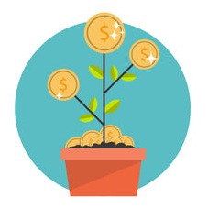
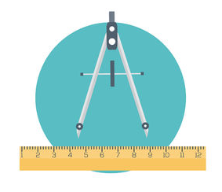
Seizing Our Chance
Cultivate sustaining investment
Build out and lead with on-the-ground “casework”
Invite additional interest and engagement with our vision and ideas
Expand the Working Table in keeping with its exceptional caliber and thoughtful to timing and composition
Begin to conceptualize and plan for inauguration of a 1st-of-its-kind trans-disciplinary “Field School” providing rotation or fellowship with WT members (down-range)
We build with a quiet and patient integrity.
We stay content and impact-driven. We keep the work on the ground.

Slide 30
PART V: Draft Agenda

Slide 31
Inaugural Working Table Meeting
Draft Agenda
 | Day 1 November 26 | Day 2 November 27
AM | A Brief to Fire Us Up! Our Story Our Chance Who’s Watching | “Drawing Board” Outputs Measurement Team Engagement
 | Open Discussion | Funding Strategy Positioning Mechanics Priorities
PM | “Drawing Board” Framing the “Board” Year 1 Fieldwork | Securing Sustaining Investment Requirement Next Steps
 | Portfolio Selection and Complementarity | Road Ahead WT Expansion 501(c)3 Considerations

Slide 32
REIMAGINE
REDESIGN
RENEW

Slide 33
The Power of “Collective Impact”
“TRANSFORMATION
is never the work of a single actor.
It is almost always the result of
powerful connection and collaboration
between
innovators, agitators, and thought leaders.”
Adapted from the
Skoll Foundation Awards for Social Entrepreneurship

