Slide 1
Pioneering Ideas in Strategy and Design at the Convergence of International Conservation and Development Practice
The Case for Working Differently
Elizabeth Walker
Executive Strategist & Field Advisor
Washington, DC
eswalker12@gmail.com
eswalker@post.harvard.edu
www.linkedin.com/in/ewalkerglobal/
March 2016
© Elizabeth Walker 2016
Notes:
I’m so happy to be with you here and to meet all of you.
Thank you for receiving me so graciously and for giving me some of your time.
I’m looking forward to being with you these next few days and to putting our heads together on something I think could be of great consequence to all of us.

Slide 2
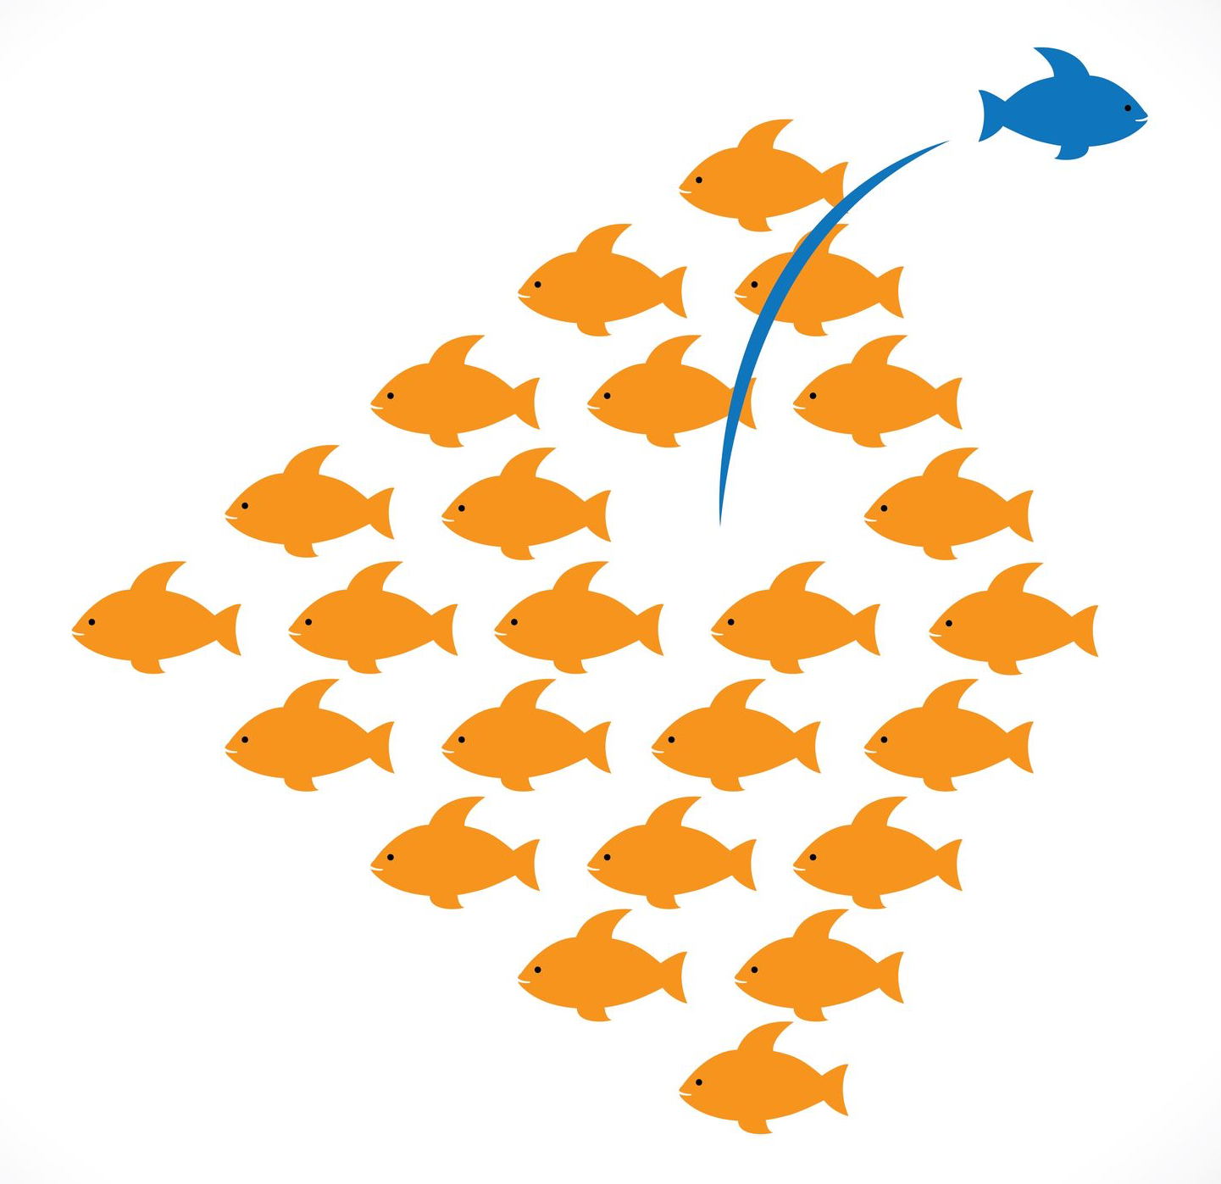
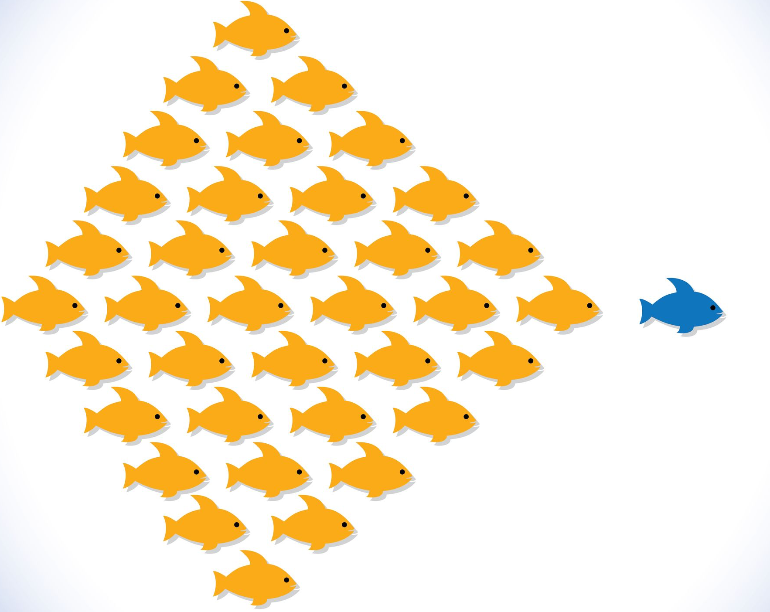
What Might It Take?
Notes:
I want to share an idea with you. It may at times be provocative, but I hope fun, intriguing and promising.
(CLICK) What might it take to change the course of our fields, the conservation and development disciplines? (By development, I include our humanitarian colleagues. And by development, I do not mean super highways and high-rise housing. I mean the GREAT EQUALIZERS, health, education, economic security, and opportunity.) Not just our cause, but our organizations themselves, our approach to our work, and the practice we ground ourselves in.
(CLICK) Is there a compelling case to be made for doing so?
I believe there is – and I believe it to be something very much worth our attention, something I think we’re remiss to reject quickly out of a comfort with convention, a loyalty to brand, or perhaps even a measure of some complacency.
So, what is it, and what might it take to run after it?!

Slide 3
The Power of the Binary
Two Views
Reconciling
Our Goals
Their Interests
Tensions
I work here!
I work here!
Integrating
Conservation
Development
Trade-Offs
Finding Common Ground
Sectoral Differences
Unlikely Alliances
Cross-Sectoral Collaboration
Despite the chatter, this is our reality.
Notes:
Let’s talk first about the larger environment we find ourselves working in. It is a binary environment – an environment of two parts, of two principal actors -- that still today governs and influences, and limits and constrains, how we operate and think.
We perceive and describe ourselves – FUNDAMENTALLY, STILL – as either conservationists (CLICK) or development practitioners (CLICK).
We work for either (CLICK) a conservation organization or (CLICK) a development agency.
While we acknowledge that ours are twin disciplines and that our impact depends on each other’s, our fields remain STILL QUITE FAR APART, with evident cost.
We insist on our separate spheres of influence and guard our specializations and representation before committees, boards and donors.
(CLICK) Acquisitions and organizational alliances are forged far more often within our fields, than between them.
We seldom see one another in our respective professional venues, and if called together, we tend to listen protectively for how we can sustain our role or our resources.
Too often (nearly always) we act and brief apart, whether we are attempting to influence choices, policy or financial investment.
(CLICK) Consider the common language we use when we find ourselves in the same space – we speak of “two views,” “unlikely alliances,” “sectoral differences,” needing to manage ““trade-offs” or “tensions,” of “reconciling” or “finding common ground,” of pursuing “cross-sectoral” collaboration, of “convincing that our goals are also in their interests.” We speak of (CLICK) “INTEGRATING.” These words are fundamentally reflective of a binary perspective. And they don’t just reflect, they REINFORCE and BIAS. And they are consistently reinforcing and biasing the conventional view that we are two (two disciplines, two fields, two sectors); we may find common cause on occasion, but we are NOT BORN nor DO WE WORK FROM A COMMON PRACTICE or STRATEGY.
(CLICK) This is NOT yesterday’s trending issue – it can feel it at times within the bubble of headquarters and loftier interagency briefings, or in the pages of erudite academic and research journals, but the reality on the ground – in the field and at the project site – stands still largely in testament to a conventional perspective that our fields work – or work best – NECESSARILY (mostly) apart.

Slide 4
The Cautious Path of Progress
INDEPENDENT
Conservation
Development
Observe & Comment
MULTIDISCIPLINARY
+
Conservation
Development
Add & Cooperate
INTERDISCIPLINARY
Conservation
Development
Synthesize & Integrate
Notes:
We have drawn closer together over the decades– we have CHALLENGED and FLEXED the presumptions and biases of a BINARY SYSTEM – with good intention and some good outcomes.
We have evolved SLOWLY, CAUTIOUSLY and PROTECTIVELY:
(CLICK) from a LARGELY INDEPENDENT APPROACH where we were distantly observant of each other’s work but not engaged in open collaboration
(CLICK) to a MULTIDISCIPLINARY APPROACH where we at times INVITED each other’s expertise (and others) to the table to add perspective, where we had common interests, while staying still firmly boundaried in our own disciplines
(CLICK) to NOW an INTERDISCIPLINARY APPROACH where we are working to SYNTHESIZE and INTEGRATE SELECT elements of each other’s methodologies and principles into our own work and at times into the fabric of our own organizations
But we have not yet BENT or BROKEN the binary paradigm in service to our reaching for a far greater impact.

Slide 5
The Interdisciplinary Appeal
Conservation
Development
Integrate select practices, methods or principles into our own business and program models
Negotiate periodic, geographic-dependent divisions of labor
Focus the bulk of our organizational attention and resources in areas comfortably within our disciplinary depth
Coordinate, adopt and adapt, without expectation to blend or replicate
Respond to market incentives and opportunities to “integrate” our programming while protecting and preserving what we feel proprietary to our own organizations, distinguishing (marketable), and ultimately supportive of revenue
It stretches and includes us, without threatening us.
Notes:
(CLICK) Nearly everything now is spoken of in an “interdisciplinary” vocabulary. We find “synergies.” We leverage “complementarity.” We strengthen “linkages.” We “integrate” metrics, and “combine” evidence bases. Why do we find the interdisciplinary approach so appealing? Why have we been relatively quick to showcase it – to showcase the “integrated programming” it espouses -- as the solution to a multi-dimensional world?
The answer may lie in what it calls us to do, and what it allows us still?
(CLICK 1) An interdisciplinary approach calls for the introduction of specific design elements or isolated considerations drawn from each other’s work into our own.
We see a community-managed conservancy
We see a project integrating a community WASH component into watershed management
We see an economic and governance project with a coastal community built in part around natural resource management
We see wildlife protection and anti-poaching messages advocated within a public health and livelihoods program
We see small-scale economic initiatives built around sustainable resource use or sustainable yield
The integration is SELECTIVE and CONTEXT-SPECIFIC, often ORGANIZATION-SPECIFIC and DONOR-SPECIFIC.
(CLICK 2) We see periodic geographic-dependent collaboration between our organizations, usually a jointly agreed division of labor, in areas peripheral to wetlands, fisheries, forests or protected areas
(CLICK 3 – 5)
(CLICK 2nd TITLE) An interdisciplinary approach has a powerful appeal because IT STRETCHES AND INCLUDES US, WITHOUT THREATENING OUR ORGANIZATIONS OR OUR MORE FUNDAMENTAL PARADIGM.

Slide 6
Is It the Right End Goal? Is It Enough?
Conservation
Development
Enforcement & Regulation
Environmental Sustainability
Remain still reflexively boundaried and at the center of our own worldviews and working models
Society/Culture/Ethics
Public Health
Economics
Public Health
Great weight of our work, both across our organizations and within our respective methodologies, remains unchanged, and our design paradigms remain largely unchallenged
Biodiversity Conservation
Human Development
Education
Economics
Education
Ethics
Imagination limited to building a discreet environmental practice within a development organization, or incorporating choice development principles and methods within receptive conservation strategies
Governance & Management
Governance & Rule of Law
Our interdisciplinary vocabulary, now well practiced, is cautious, at times hollow, tired, and protective
Are we stuck confusing complementarity and tactics
for vision and strategy?
Notes:
But is it the right end goal? Is it enough?
In the Board room and in practice, our OWN working business models offer an interesting insight. We’ve built our working interdisciplinary models with ourselves at the center. Our conventional models are too often TWO-DIMENSIONAL VARIATIONS ON A THEME. (CLICK) Biodiversity conservation sits at the CENTER OF THE WHEEL, with other fields of relevance or impact to our conservation objectives depicted as “spokes,” be they the regulatory environment, law enforcement, social/cultural considerations, economics or ethics. (CLICK) Likewise, the development community sits at the center of its own working model, often with the fields of economics, ethics, governance, education, health and even the environment as its “spokes.”
(CLICK) In essence, despite progress towards A KIND OF CAUTIOUS CONVERGENCE OF OUR INTERESTS, an “INTERDISCIPLINARY APPROACH” leaves each of our disciplines at the center of our models, and doesn’t fundamentally challenge a BINARY SYSTEM predicated on the assumption that, by virtue of our objectives, our disciplines are not wholly compatible.
And the CONSEQUENCE of this is that…(CLICK 1 & 2)
When we limit ourselves to (CLICK 3)…there is no wonder why conservation groups question why development practitioners aren’t more attentive to environmental concerns and consequence as part of the unbreakable link between nature and humanity’s survival, and equally why development practitioners marvel at why wildlife managers and conservationists call up stale development models whose promise they believe has long diminished (“capacity building, gender inclusion, stakeholder participation, rights-based approach, local ownership”)
(CLICK 4) Our interdisciplinary VOCABULARY, while well now in practice, is cautious. Our words reflect an approach that is CAREFUL, ITERATIVE AND INCREMENTAL.
I worry we’re at risk of getting ‘stuck’. TWO REASONS:
1) Because we’re COMFORTABLE. The boundaries that separate and define us are familiar. (They are enforced and re-enforced by our interagency, our boards, our donors, and our own language.)
2) We are quick to fear that any further convergence risks diminishing our specializations (and thereby our BRANDING and our FUNDING) or diluting and disrupting our signature methodologies or our science, so we STAND OUR GROUND and PROTECT CONVENTION (this is a natural inclination both as organizations and as practitioners).
(CLICK 2nd TITLE) By keeping our focus and our metrics simply on integrating each other’s expertise and methods into our own disciplines, where we find opportunity, common cause, or investment, we are sticking, confusing complementarity and tactics for vision and strategy.

Slide 7
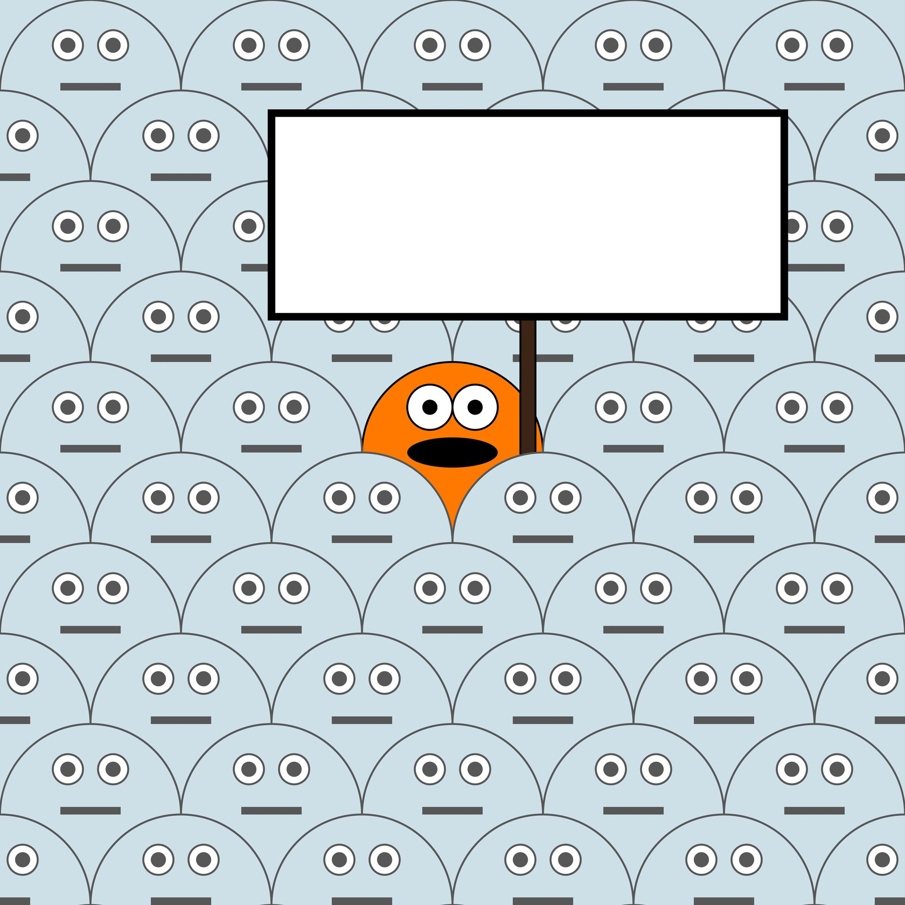
What If…
?
…we unite behind a common strategy?
…we start converging?
…we build one practice?
…we stop integrating?
…we were more effective?
Notes:
So…what if! What if something AMAZING – something BIG – is sitting within reach that could have a profound impact on our ability to make a difference and to secure the kind of future we aspire to?
(What PRACTICAL and IMPACTFUL INSIGHTS sit untapped at the DEEP CONVERGENCE of our fields? What are the implications for our disciplines and our organizations?)
(CLICK) Is it time that we STOP INTEGRATING and (CLICK) START CONVERGING? Is it time that we envision and build a (CLICK) SINGLE PRACTICE THAT TRANSCENDS OUR DISCIPLINES, (CLICK) UNITED BEHIND A COMMON STRATEGY? (CLICK) HOW MUCH MORE EFFECTIVE COULD WE BE?

Slide 8
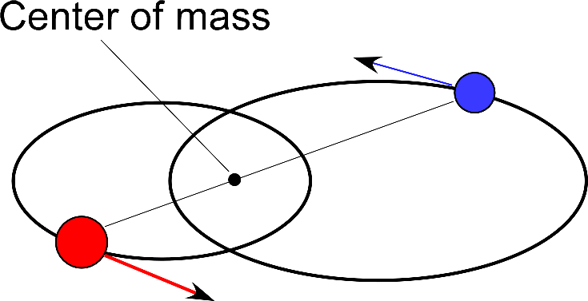
A Point of Stellar Reflection
Binary System:
A system of two objects, which are so close that their gravitational interaction causes them to orbit about a common center of mass.
Some definitions REQUIRE that this center of mass NOT be located within the interior of EITHER object.
(Source: Wikipedia)
Notes:
It’s interesting – and perhaps fun – to return for a minute to the definition of a BINARY SYSTEM. (CLICK) It is a system of two objects that, in stellar terms, are in a kind of orbital dance around an often invisible center of mass.
(CLICK) This center of mass – this center of GRAVITY – is NOT within either one of them. It stands between and apart.
So the question it raises is: WHAT IS – WHAT SHOULD BE -- OUR CENTER OF MASS, OUR CENTER OF REAL GRAVITY, OUR CENTER OF GREATEST IMPACT? And should our goal be to redefine our disciplines and our organizations - not in orbit of it – but ultimately within it?? To converge TO IT??
(CLICK) Could this center of gravity be a new kind of PRACTICE? A practice that breaks the binary?

Slide 9
What Happens When We…
Acknowledge that disciplinary boundaries remain in interdisciplinary models? That the presumptions and tensions they bias erode progress? That our selective, periodic integration of disciplines is nowhere near on pace to produce systemic change at large scale?
Re-imagine an approach to what we do that:
Upends constraining assumptions
Retires tired terminology
Replaces stale methodologies and metrics
Elevates our dialogue
Unites us in cause and accountability, and
Keeps our focus at once visionary and strategic?
Institutionalize not just an appreciation for the other’s discipline, but a foundational understanding of our reciprocal and indisputable obligation to work with a single purpose, within a shared strategy?
We change the conversation in fundamentally
transformative ways, as we do our approach.
Notes:
(CLICK) through

Slide 10
We Change the Paradigm
The Environment!
Conservation
Development
Human
Needs!
We ground the totality of our work within each of our organizations in a shared strategic framework…
…that truly marries sustainability, stewardship and development across concept and practice…
…informing each and every element of project design…
…answerable to the requirements and aspirations of our era.
Notes:
(CLICK) Rather than selectively incorporating people-centered development principles AND METHODS within conservation strategies, or (CLICK) building a limited environmental practice area within a development organization…
Rather than speaking (CLICK) of the “human dimensions” of conservation work, or (CLICK) of the “environmental dimensions” of development work…
Rather than (CLICK) rendering our conservation work within a human framework (be it about valuation, survival or security) or (CLICK) our development work within an environmental framework (be it about resilience, adaptation or climate change)…
(CLICK) we INSTEAD TALK as a matter of course about the FULL AND NECESSARY DIMENSIONS of ANY ENGAGEMENT THAT SEEKS TO SUSTAIN AND PROTECT LIFE IN ALL ITS FORMS
(CLICK) through

Slide 11
We Transform Our Practice
INTERDISCIPLINARY
Conservation
TRANSDISCIPLINARY
Development
MULTI-
DISCIPLINARY
INTER-
DISCIPLINARY
TRANS-
DISCIPLINARY
Additive
Inclusive
Opportunistic
Cooperative
Integrative
Selective
Incremental
Iterative
Convergent
Expansive
Dynamic
Accelerated
Notes:
(CLICK) We break out from WITHIN THE CONVENTIONAL BOUNDARIES of our fields. We ACHIEVE A DEEP CONVERGENCE that POSTIIVELY TRANSFORMS HOW WE WORK.
In essence, we will have moved from a multidisciplinary outlook (CLICK) to an interdisciplinary (CLICK) one and now to one that TRANSCENDS DISCIPLINES (CLICK), that is TRANSDISCIPLINARY, that calls not for integration BUT CONVERGENCE, and reflects a MORE DYNAMIC and EXPANSIVE understanding of our work and obligations, for accelerated impact.

Slide 12
Our Language Matters
Approach
Vocabulary
Language
Meaning
Intent
Focus
Expectations
Results
Outlook
Vocabulary
CHANGE
Change the language, and we change the meaning. Change the meaning, and we change the conversation. Change the conversation, and we change expectations. Succeed, and we change the future of our practice.
Notes:
So let’s TRANSFORM BY TRANSCENDING.
(CLICK) FIRST BY CHANGING OUR OWN VOCABULARY.
(I’m struck by the extraordinary power of language. It DRAWS OUR ATTENTION, and IT FOCUSES IT. It defines. It clarifies. It REVEALS INTENT, it creates expectations, it sets our pace, and ultimately it DEMANDS OUR ACCOUNTABILITY.)
(CLICK) Let’s substitute TRANSDISCIPLINARY for interdisciplinary. Let’s retire the popular turns of phrase like “complementarity, synergies, linkages and mainstreaming” that have become ubiquitous, but have lost meaning and too often fail to translate on the ground to measurable change. Before we overlay the buzz words of our tech colleagues, before we “scale, innovate and incubate,” LET’S TAKE ANOTHER LOOK AT OUR INTENT, THE END GOAL, AND WHETHER OUR DISCIPLINES ARE KEEPING PACE.
Let’s STOP TALKING ABOUT THE “INTEGRATION” OF OUR PROGRAMMING AND START TALKING INSTEAD ABOUT THE “CONVERGENCE OF OUR APPROACH.” LET’S UNITE BEHIND A STRATEGY BUILT ON LANGUAGE THAT REFLECTS A DEEP CONVERGENCE in philosophy and practice TRANSCENDENT OF OUR FIELDS.
(If we don’t, we continue a common “window-dressing” pattern where every few years, we open a new dictionary of descriptors to update our marketing, but less so our practice. Despite the best of intentions, research and erudite scholarship, the chasm between theory and project site remains.)
(CLICK) THIS IS A LANGUAGE that doesn’t “window dress,” but rather (perhaps uncomfortably at times) DEMANDS A FUNDAMENTAL – AND RECOGNIZABLE – SHIFT to how we approach and design our work on the ground. Because THAT’s the only thing that MATTERS. If we can find that language, it can change a lot, perhaps EVERYTHING.
(CLICK) 2nd TITLE
What’s exciting is that we’re hearing some new language that reflects a transdisciplinary movement, whether intended or not.
The newer frames used within the conflict management and climate change communities: “environmental security,” “climate security,” “climate and social resilience” and “ecosystem-based adaptation.”
Work done by Michele Marvier and Peter Kareiva introducing “conservation science,” and advocating strategies that maximize benefits to biodiversity and people
The “ONE Health” movement and
Very recently the Breakthrough Institute’s and others’ call for an “ecomodernist” paradigm.
Irrespective of what we may think of the promise or limitations of their various dimensions and applications, or of their controversies, THESE ARE PROVOCATIVE CHANGES that recognize the power and bias in our VOCABULARY.
They begin to illuminate that a STRATEGY and a FRAMEWORK that unites and transcends our disciplines is WITHIN REACH.

Slide 13
A Unifying Strategy Matters
Create
Renew & Rethink
Unify
Close the Gaps
Attentive
Accountable
Unharness Talent
Ignite Imagination
Vision
Strategy
Design
Outcome
TRANS-
DISCIPLINARY
Dynamic
Expansive
Transformative
Balanced
Strategic
Scale of Change
Designing from a common strategic framework, that transcends our disciplines, unites us in cause and accountability.
Notes:
And it’s within reach if we converge on a STRATEGY.
We can build a strategy that, while acknowledging of our disciplinary strengths, is NOT HOSTAGE TO THEM.
(CLICK) We seek an IMPROVED OUTCOME ON THE GROUND AT OUR PROJECT SITES. We seek to put NEW, PROMISING IDEAS to work on the ground NOW that marry the best thinking across disciplines, in a manner and pace that gives us a GREATER SCALE OF CHANGE. That turns on our unharnessing talent and imagination. [In everything we do, the value of any engagement should be measured through a SINGLE METRIC: Are we delivering better, deeper, faster, and more promising work? As Winston Churchill said, “However beautiful the strategy, you should occasionally look at the results.”]
(CLICK) An improved outcome turns on EXCEPTIONAL PROJECT DESIGN, design that commits our attention and resources in a balanced and strategic way, that holds us accountable to a higher bar of understanding, performance and impact -- PRECISELY BECAUSE we would be MOVING AWAY FROM CONVENTIONAL DESIGNS THAT FRAGMENT OUR WORK BY DISCIPLINE and instead CREATING DESIGNS that transcend them, regardless of scale. As I have told nearly every organization I have worked with, we have far more DESIGN problems than we do RESOURCE problems.
(CLICK) EXCEPTIONAL DESIGN IS AS MUCH THE PURVIEW OF STRATEGISTS AS IT IS OF TECHNICIANS. A technically sound design absent a compelling strategy produces outcomes that cannot last or be replicated. A good strategy will call for us to tend to interests traditionally guarded within the other’s purview, to prioritize work outside the scope of our conventional technical interests. Exceptional design is therefore born from strategy that CLOSES THE GAPS BETWEEN OUR FIELDS, and celebrates the connections and obligations between them. It’s a strategy that is dynamic, expansive and transformative.
(CLICK) A STRATEGY UNANCHORED BY VISION IS SIMPLY A FRAMEWORK OF TACTICS. We seek a FRAMEWORK OF IDEAS, one that reflects a vision of our fields as more than a collection of specialists, but an EXTRAORDINARY WELL OF TALENT that can be moved to RENEW and RETHINK CONVENTIONAL PRACTICE. (Innovation – however we understand that word -- is NOT a luxury; it is a RESPONSIBILITY.)
In order to deliver impact (CLICK), our focus must be here (CLICK) – on our strategy and, through it, our design. [This seems just good common sense, and it is a compulsory part of every proposal and briefing, but at an institutional level, we consistently expend far more time and treasure on fundraising than we do minding strategy and refining our work’s design.
(CLICK) By grounding our work in a common strategic framework that reflects a transdisciplinary vision, BORN NOT FROM CONCERN FOR SELF-PRESERVATION BUT FOR COMMON ASPIRATION, WE BIND OURSELVES TOGETHER IN CAUSE AND ACCOUNTABILITY – and this, I believe, is powerful and transformative.

Slide 14
Can We Develop a Common Strategic Framework that…
Inspires movement away from the language of a conservation and development binary?
Is ground-rooted, elegant and persuasive?
Illuminates and guides, without prescribing or demanding uniformity?
Tests and advances a promising theory of change?
Challenges each and every engagement our organizations undertake, whether alone or in partnership, to be considerate of, informed by, and answerable to a difficult, but pivotal, balance of disciplines?
Promotes an internal rebalance within our own organizations between specialization and generalization, recognizing that fielding experts and versatile generalists (scientists and strategists) is essential?
…uses the binary not to bind our work, but to lift it?
Notes:
We rightly need to ask ourselves some important questions. (CLICK) through.
(CLICK 2nd TITLE)
And if we want to recognize that on some level, a conservation and development binary is a FAIR REFLECTION OF THE TRADE-OFFS AT TIMES IN OUR CHOICES, then let us set it carefully within a framework that uses that binary NOT TO BIND OUR WORK, but to LIFT IT.

Slide 15
An Illustrative Strategic Framework
What
Trans-Disciplinary Design Approaches Sit Here at the Balance Point ??
Civil Engagement
(Independence, Protection,
Viability, Vibrancy)
Convergence
Justice
(Civic & Environmental, Rights, Remedy, Enforcement, Incentive, Consequence)
Governance
(Institutional & Regulatory Efficacy, Accountability, Transparency, Participation)
Why a Model in Motion?
Exceptional design requires both a pivotal BALANCE of considerations and, importantly, MOMENTUM.
As the “Design Disc” spins atop
the point of its base, the balance of our disciplines both stabilize and propel it. Its spin ultimately “blurs” the conventional separation
between our fields, and its momentum gives “lift” to the five anchoring tethers of our work and obligation, what can be thought of as five universal “Levers of Change”
(Justice, Equity, Stewardship, Governance, Civil Engagement).
Their “lift” ultimately gives
the scale of change we seek
its real force, no matter
our core discipline.
Project
Design
Spin Weight
Spin Weight
Conservation
Development
PROGRESS
Equity
(Power, Access, Inclusion,
Distribution, Responsibility)
Stewardship
(Human & Wild, Population & Community,
Natural, Human & Financial Capital)
What is the cost of our approach being “out of balance”?
Conflict, Displacement, Disinterest, Disenfranchisement, Rights Violations, Corruption, Criminality, Overexploitation, Environmental Degradation,
Habitat, Migration & Biodiversity Loss
© Elizabeth Walker 2016
Executive Strategist & Field Advisor
www.linkedin.com/in/ewalkerglobal/
Notes:
An idea…just one…there could be many, there could be many better…but an idea for what could be an illustrative STRATEGIC FRAMEWORK THAT CAN HELP TO BREAK THE BINARY and SERVE AS WELL AS A PRACTICAL DESIGN TOOL, NO MATTER OUR CORE DISCIPLINE
This is a different kind of model. Prevailing conventional models are two-dimensional and stationary. They are FLAT DEPICTIONS OF “FLAT” CONCEPTS. They’re unable to capture the often dynamic nature of the challenges we confront, and the consequences we generate. They usually FAIL AS A RESULT TO STIMULATE TRULY BREAK-OUT THINKING OR BREAK-OUT RESULTS. While a model like this is unable to “animate” itself from the page, it’s intended to be visualized in a three-dimensional space, and to be visualized in motion. Perhaps fittingly, you have to use your imagination to animate it.
It’s a model in motion like a carrousel. Its motion is the best way to explain its meaning…(CLICK)
The question it invites is: What promising transdisciplinary design approaches sit at THE SWEET SPOT?
(CLICK) And the cost of our understanding and approach being “out of balance”…we know too well.
A model like this is intended to SPEAK IMPLICITLY TO THE COMMON ORIGIN OF THE CHALLENGES WE CONFRONT, and EXPLICITLY TO THE SHARED REQUIREMENTS OF OUR RESPONSE.
It’s meant to underscore that each of the challenges we confront, no matter where we find them or how we are called to them, are manifestations of a COMBINED FAILURE OF CONSERVATION AND DEVELOPMENT. That the two cannot be separated in causation. And nor can they be separated from the critical dimensions that anchor and animate them.
It’s meant to underscore that if, in our actions or reactions, we FAIL TO CONSERVE AND DEVELOP – NO MATTER THE FRAME WE PUT AROUND our work – we will fail to meet the demands of our time. While our projects may meet short-term objectives, our work will fail to ignite systemic change at large scale. (If, for example, our focus remains exclusively or even fundamentally about ecological research, eco-friendly livelihoods and law enforcement on one hand, or about poverty alleviation, livelihood preservation and democratic governance on the other, our work is destined to be out of balance, out of depth and will fail to sustain impact.)
It’s meant to inspire movement TOWARDS A FOCUS ON FULL ECOSYSTEM or NETWORK INTEGRITY, HUMAN AND WILD, BIOLOGICAL, SOCIAL, POLITICAL, JUDICIAL AND ECONOMIC, IN ALL SETTINGS AND CIRCUMSTANCE, REGARDLESS OF THE SCALE OF WHAT WE ARE ADDRESSING OR DESIGNING.
Five important attributes:
1) Notice that the “center” of this framework is NOT either of our disciplines, but rather “PROGRESS.” The more we actually VISUALIZE – back to the stellar system – that the center of gravity (of impact) lies apart and between us, the more impactful we will be, and the less reflexively protective we will be of convention and brand.
2) The framework IS AN ARGUMENT FOR A “WHOLE-OF-SYSTEM” or “WHOLE-OF-NETWORK” APPROACH, SO THAT OUR WORK CAN BE EFFECTIVE AND ENDURING. (We tend to readily recognize this in our language but often fail to adequately incorporate it in our design work.) We EACH must expand what falls within our range of responsibility to consider, balance, mitigate or protect, or what we should be mindful not to trigger or escalate. Our impact will otherwise be hollow, counterproductive, muted over time by a failure of individual or institutional incentive, and too often short-lived. [Without attention to the integrity of justice systems, for example, enforcement (whether it be of poaching or human rights protections) will be weak; without equity, governance and regulation will be hollow; without civilian space, little of what we support or help create can be expected to sustain.]
3) Setting the model IN MOTION is to underscore that the system of LIFE ITSELF is DYNAMIC and its parts dynamically AT PLAY. There is a kind of “UNITY OF THE WHOLE; AUTONOMY OF THE PARTS” philosophy that underpins both my central contention as well as the framework model itself. Exceptional project design comes from understanding how the system operates, how it’s in motion, and the creative tension and feedback loops that exist between its various parts that magnify, or disable, progress. Its parts balance, restrain and propel each other in accordance to the ATTENTION WE GIVE THEM -- creating a kind of multidimensional system of weight and balance -- and speed. Its parts are NOT IN CONFLICT with one another (not philosophically, not conceptually, and not operationally). They are WHOLLY INTERDEPENDENT. If they are thoughtfully tended -- if we THOUGHTFULLY DISRUPT AND THOUGHTFULLY REBALANCE -- we have then a kind of HARMONIZATION OF EFFORT (a HARMONY OF DESIGN) that gives us balance, momentum and lift, symbolic of an accelerated scale of change. (We can even reach a kind of positive tipping point where MOMENTUM is maintained through the model’s mutually reinforcing efficiencies, where ongoing impact on any one variable can sustain the speed and lift of others (imagine a game of multi-ball tetherball)).
4) It’s fair to question the POTENTIAL (significant) IMPLICATIONS OF A MODEL LIKE THIS TO OUR ORGANIZATIONS AND OUR TEAMS. Would it compel our teams to address equally every tether and variable reflected here, or to expect our projects to impact them all equally? No. That would be impractical, inadvisable and, from a physics standpoint with the model in motion, unnecessary. Leverage and sequencing, and prioritization, will always matter. Would it challenge us however to look with fresh eyes at what span of engagement is possible and necessary? Yes. Would it invite us to rethink and remap our own organization’s “boundaries,” our core competencies – as doing so would not only NOT DILUTE our core values, it would PRESERVE THEM? Yes. Would it inspire our organizations to begin to re-mold and re-define, to evolve into something more than purely a conservation organization, or a development one? Perhaps. Would it support an argument, as a matter of strategy, that a coalition of organizations, capable of a broad, balanced and harmonized scope of creative work, be a prerequisite to any engagement? Perhaps. Would it compel us to recognize the significant “IMPACT DIVIDEND” a deeper convergence of disciplinary expertise brings, not just across a coalition of our organizations but within them? Yes.
5) Irrespective of all of this, the framework suggests something immediate and important purely from a conservation standpoint. We’ve got to do better than simply brand our work “PEOPLE-CENTERED or COMMUNITY-CENTERED CONSERVATION,” and define that approach by our attention to perceptions, behaviors, incentives, and resource strategies, our study of communication and theories of behavior change, or our incorporation of RBA models, livelihood studies and social research. Conservation is more than just a “social process.” And we must do more than simply “take account of human needs” and “human agency.” While new attention to “working landscapes,” “ecosystem-based adaptation,” and “spatial planning” are promising, our obligations to people and societies – and the system of life itself -- in fact exceed it.
EQUALLY, the framework suggests we’ve got to do better than SIMPLY RE-BRAND OUR DEVELOPMENT WORK under the now popular guise of “climate change adaptation or resilience” or “climate and social security.” While this new labeling can make for a kind of EASY ON-RAMP TO CAPTURE DONORS oriented or pivoting towards environmental causes, it has largely failed to produce a proportionate change to development methodology or design. Nor, can we continue to shield development work from ripe critique by emphasizing our commitment to “sustainable development.” Without recognizable change to how we perceive our fundamental obligations as practitioners, the labels are trendy but too often hollow. They’re white noise…background static.
[Note: An interesting CASE STUDY, just one, to look at through the prism of a framework such as this is how each of our disciplines confronts the TWIN atrocities of the illegal wildlife trade on one hand and human trafficking on the other. Trafficking of ANY KIND results from the same fundamental and potent mix of destitution and opportunity. Their commonalities are striking, and so too must be our response. Does a framework like this help demonstrate that BOTH forms of illegal cross-border crime showcase a failure of policy, enforcement and incentive – that trafficking by its nature, no matter its target, is born from a COMBINED FAILURE of conservation AND development – that where illegal trafficking occurs, the disc is NOT spinning so to speak, the tethers that should anchor our work and give momentum to the change we seek (justice, equity, governance, civil space, and stewardship) are NOT ADEQUATELY TENDED? If so, it would suggest that were they to be, such multi-dimensional efforts to eradicate one form of trafficking would weaken the systemic foundation of its other forms. How much more effective could we be were we to recognize the common roots of our targets and act on them together?]
So whether or not we use a framework and design tool like this commonly, ACROSS DISCIPLINES AND ORGANIZATIONS IN A TRANSDISCIPLINARY SPIRIT, we should at the very least MINE it, or something like it, for what it can remind us we may be failing to consider, engage and influence within our own work.
And should a coalition of organizations stand up at a site, perhaps it reminds us of the crucial scope and balance necessary for our joint efforts to really impact.

Slide 16
Our Imperative
Is a framework like this in positive service to the field, in practice?
“In theory, there’s no difference between theory and practice. In practice, there is.”
Yogi Berra, Celebrated American Baseball Player
If we put it in the hands of our colleagues, will it positively change how they view their work and responsibilities? How nimbly they lead? How creatively they design?
Can its use help lead a redefinition and reinvention of our practice, a practice united behind a transdisciplinary vision, that binds us together in cause and accountability, with practical tools that guide and reinforce a “whole-of-network” – a “whole-of-life” – approach at every project site and in every meeting room?
If not, what will?
This is the calling of our time, our obligation –
and an invitation to work together to answer it.
Notes:
As Winston Churchill said, “However beautiful the strategy, you should occasionally look at the results.” We have a single supreme imperative with any effort like this.
(CLICK) through
(CLICK) And if the answer is no, then what will?
(CLICK) Because this is the calling of our time.

Slide 17
The Future It Can Inspire
We reject binaries. We retire talk of tensions, trade-offs and divisions.
We strive for exceptional delivery to a shared strategy, not to dominate, preserve or capture space in a field.
We design from a new paradigm answerable to both the requirements and aspirations of our era.
We connect our organizations and our ideas in service to an enduring impact; we don’t entrench and shield them in service to a funding line or a brand.
We place a premium on staying relevant, not viable.
We insist on creative license and experimentation as telltale marks of transformative leadership.
We critique our own marketing and abandon stale methodologies
We embrace a fuller accountability on the ground, recognizing our obligation to anchor our work across disciplines and old boundaries.
We harness visionary funders to our ideas, not our ideas to available funding.
This is a future – this is a practice – worth creating, and attracting.
Notes:
And it’s an invitation to inspire a future that is an exciting – AND OVERDUE – one.
(CLICK) through

Slide 18
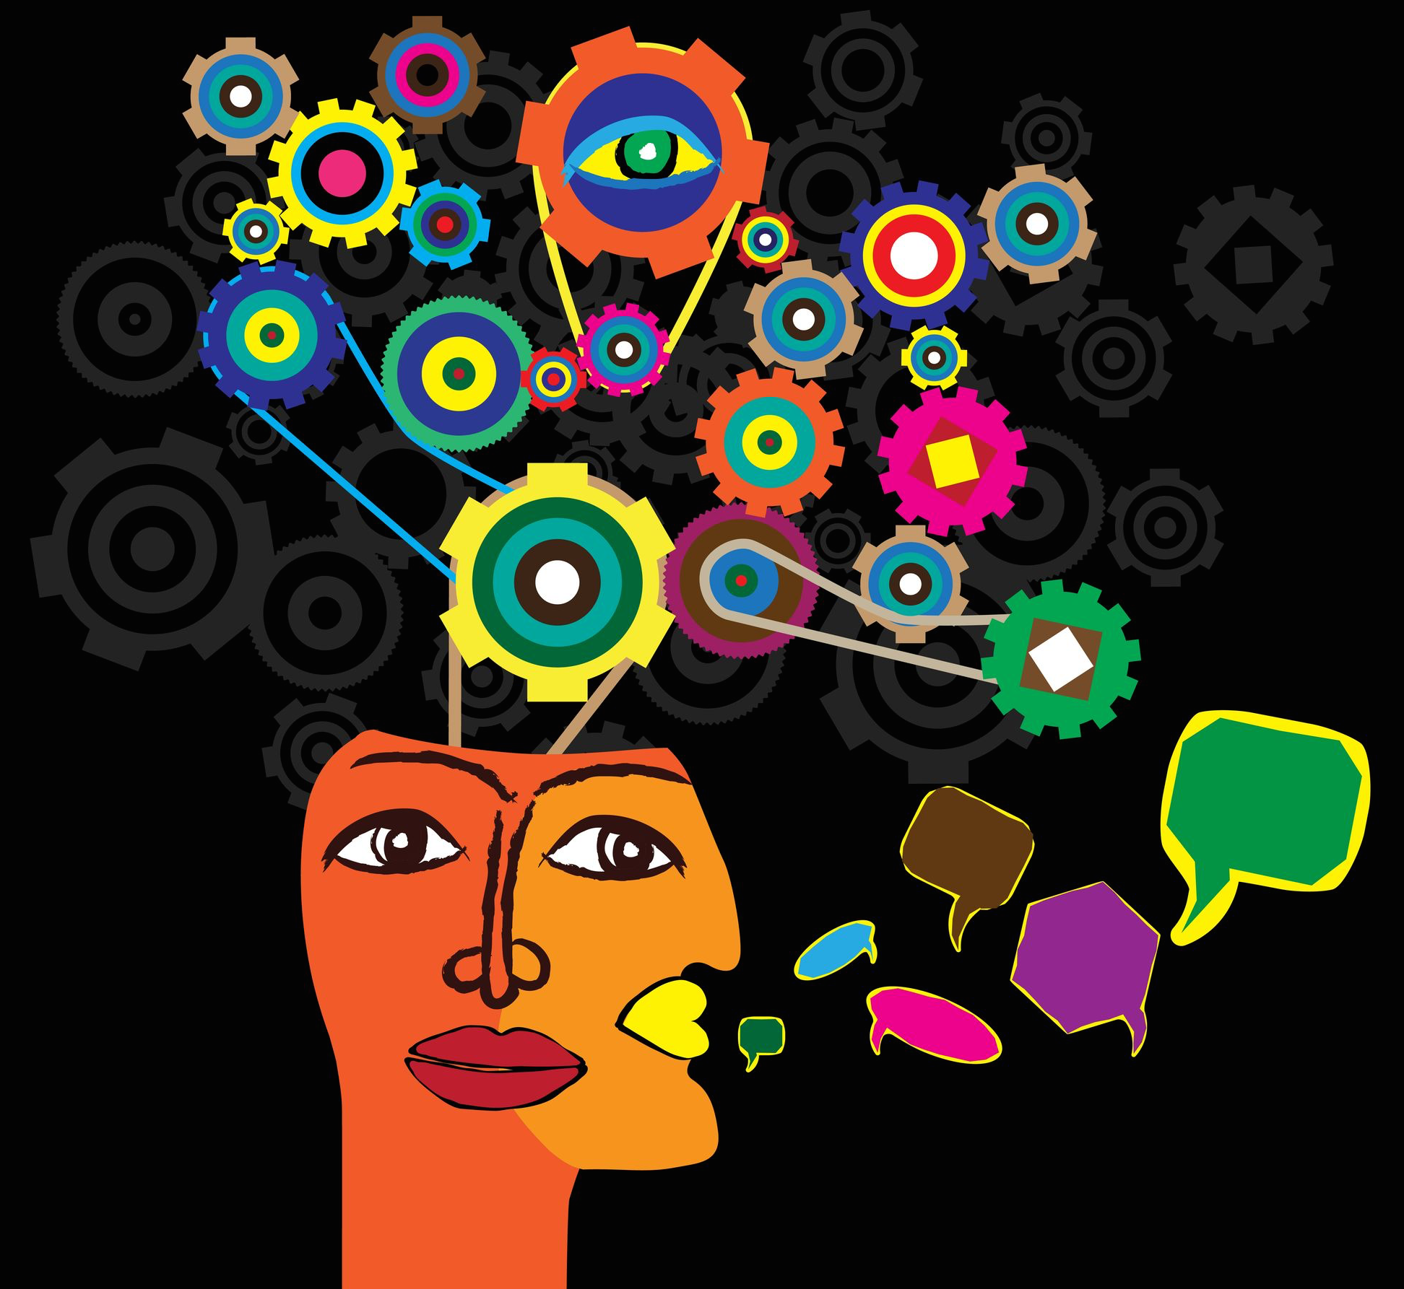
“It is better to fail in originality than to succeed in imitation.” Herman Melville, 19th Century American Author & Poet
What might we succeed at if we look (again) at what lies at the deep convergence of
our talents and expertise? At a convergence that defies the conventional boundaries, purviews, and biases keeping our sights fixed cautiously on “integrated programming,”
rather than on a far more powerful convergence of approach?
Notes:
I’ll leave you with two parting (or beginning) thoughts.
What might we succeed at…a convergence that defies convetional boundaries, purviews and biases THAT KEEP OUR SIGHTS FIXED ON INTEGRATED PROGRAMMING OR INTEGRATED RESEARCH RATHER THAN ON A MORE POWERFUL CONVERGENCE OF APPROACH.
WHAT CAN IT UNLEASH AND INSPIRE?

Slide 19
“Chance Favors the Connected Mind.” Steven Johnson, Where Good Ideas Come From: The Natural History of Innovation
Where do we go from here??
1) Let’s turn over the ideas together…let’s unpack their promise and potential.
2) Let’s explore their application to existing and emerging models of work.
3) Let’s “free-think” what a field collaboration can look like
to test and advance their impact.
Let’s unbind thinking and work to accelerate progress!
You can reach me in Washington, DC through:
eswalker12@gmail.com
eswalker@post.harvard.edu or
www.linkedin.com/in/ewalkerglobal/
Thank You!
Notes:
Let’s work together.

Slide 20
The Power of “Collective Impact”
“TRANSFORMATION
is never the work of a single actor.
It is almost always the result of
powerful connection and collaboration
between
innovators, agitators, and thought leaders.”
Adapted from the
Skoll Foundation Awards for Social Entrepreneurship

Slide 21
Concepts & Principles/Discussion Slide: Questions A New Framework Invites
Is it a different kind of thinking tool? Could it compel creative re-design? Does it allow for more, encourage more, and expect more?
Does it challenge conventional models of practice and binary paradigms? Does it invite us to move outside our institutional comfort zones, to think more broadly, flexibly, or creatively, to re-frame?
Could it improve concretely how we design projects? How we talk about them? How we staff them? What we expect from them?
Could it change how we work, not just within readily receptive projects or portfolios, but across each of our organization’s engagements?
Could it influence how we partner, how we approach government, policy and financial engagements, or how we think about systems and markets as a force for change?
Might it change how we fund and market our work?

Slide 22
Practical Application/Discussion Slide: Questions The Ideas Invite In Practice
Table-Top Case Study?
Do they hold promise? Tangible potential?
Do they resonate?
What practical impact do we see to the organization?
What do these ideas mean for how we work and brand? Would they disrupt? Confuse? Inspire? Rebalance?
How would they influence our own current working model? Would they affirm? Refine? Expand? Reject? Challenge?
Would they enhance our strategies? Bring greater coherence and balance to our designs? Energize adjustments to leadership and staffing? Reveal new partners?
Could they ignite and accelerate impact? Help create and sustain change? Enable deeper reach and, in time, at larger scale?
Could they attract, inspire, and excite revenue?

Slide 23
“Collective Impact”/Discussion Slide: Questions A Field Collaboration Invites
What can an elite field-based collaboration that tests and refines these ideas in practice look like?
How can we build momentum behind a kind of “Proof of Concept” or “Proof of Impact” effort?
What would we want that to look like?
Do we want to inspire a “curated” effort across missions, countries and scale of organization?
How can we give it life, reach, and exposure?

